Slide 1
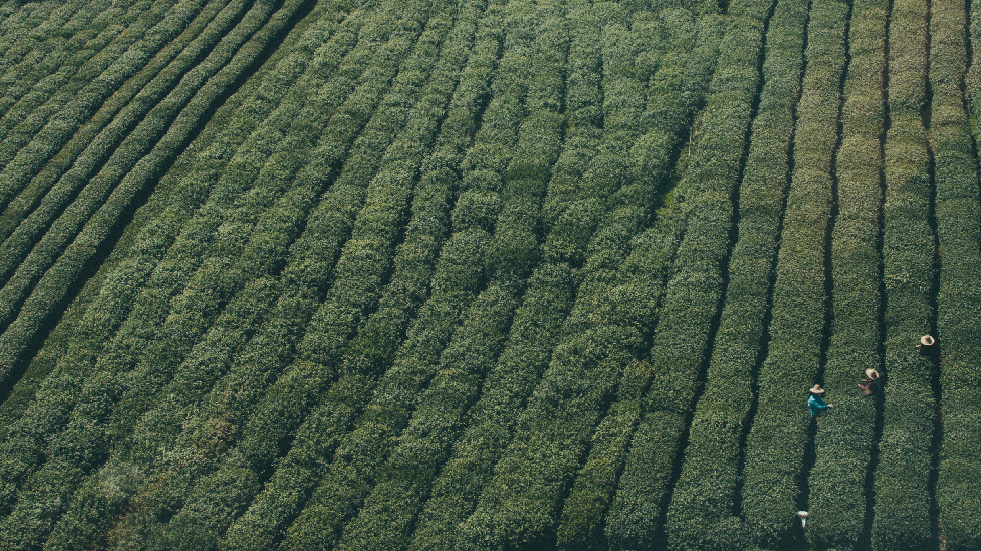
SYNAPSE
G R O U P - 8
Sichai Niyantran Upkaran
“ KI SHAAN KI UNNATI , DESH KI PRAGATI …”
GUIDED BY:-
Prof. Dr. Pravin Gundalwar
Prof. Sneha Rane

Slide 2

GROUP MEMBERS
Definition of Any of a range of
_{Alternative} medical therapies that
are not regarded as
_{Medicine} orthodox by the medical
profession, such as
herbalism, homeopathy, and acupuncture.
Komal Thakur
Mukesh Verma
Avinash Varma
Vinit Tiwari
Amit Vishwakarma
Arjun Varma
Aman Tripathi
V aibhav Trangadiya
Manish Tiwari
Aarti V ishwakarma
Manish V ishwakarma
Niraj V ishwakarma

Slide 3
GROUP MEMBERS
Definition of Any of a range of
_{Alternative} medical therapies that
are not regarded as
_{Medicine} orthodox by the medical
profession, such as
herbalism, homeopathy, and acupuncture.
V V Prateek Premanand
Varghese Justin Joseph
Velankar Tanvi
Sachin Vishwakarma
Amitkumar Vishwakarma
Arbind Yadav
Arunkumar Y adav
Rohit Y adav
Priyanka Y adav
Rahul Sharma
Rohitkumar Y adav
Shivkesh Y adav

Slide 4

MASCOT
alternative medicine users

Slide 5
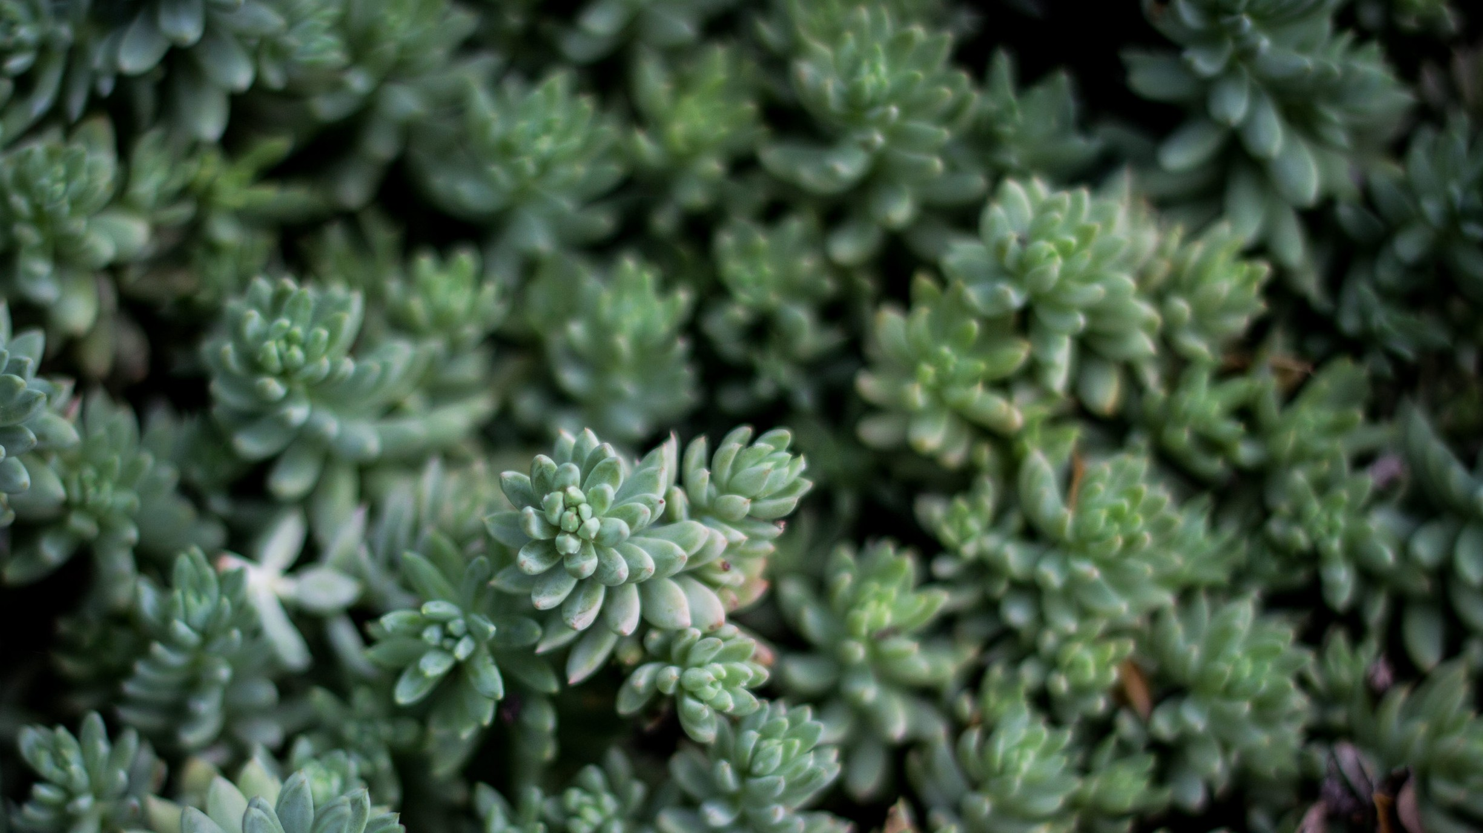
Introduction
The demand for food is constantly increasing -> better production of crop is essential to fulfill the demand.
W ater plays an active role in the development of the crops -> better crops leads to the high yields.
W hen to water and how much to water ?
Use of correct Soil moisture sensors.
Proper water control information is possible through the use of I nternet of Things ( I o T).

Slide 6
Objective
- The aim of this Proj ect is to make Optimal use of water.
Minimize the farm work and automate the i r r igation system.
Provide real t ime update about the required water level.
The application can be controlled using Smartphone' s .
Develop Technology based Farming.

Slide 7
PROBLEM STATEMENT
Definition of Any of a range of
_{Alternative} medical therapies that
are not regarded as
_{Medicine} orthodox by the medical
profession, such as
herbalism, homeopathy, and acupuncture.
Major Problem of Indian Agriculture
Agriculture in India depend on monsoon.
Soil Infertility
Climate Instability
Water Management
Time Management
Water logging
Ground Water
Hence “Sichai Niyantran Upkaran”.

Slide 8
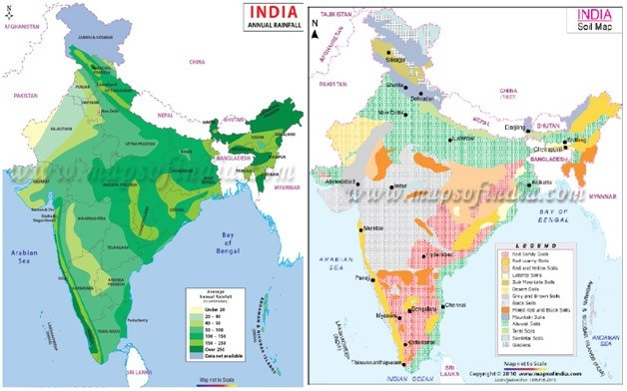
Finding problem and area for solution

Slide 9
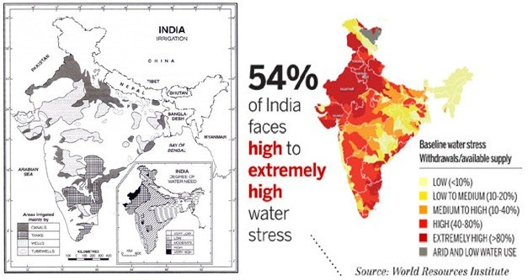

Slide 10
Since we can use our device in above denoted graph wherever all condition are suitable (vegetation, soil, irrigation, water stress).
Our system will also helpful for those who are already using water irrigation (drip irrigation, etc..) with the use of our advance wireless technology.

Slide 11
Proposed System
The system is designed to equally distribute the f low of water across the f ield.
Farmer can remotely control using Smartphone the f low of water as per the need.
System is installed with soil moisture sensors at every water outlets, to manage & control the moisture of soil.
Farmer can get f ield information on one f inger t ip.
- W e are using cloud based AI to automate water supply.

Slide 12
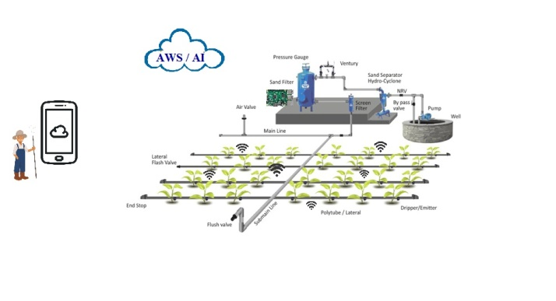

Slide 13
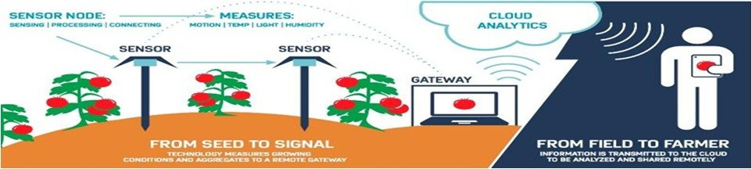
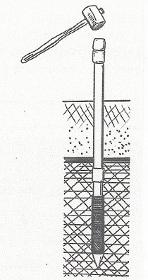
In cloud analytics we are using AI to analyses how much water will be used, depending on factors like climate, plant growth, humidity, soil and so on with respect to standard crop (Grass).

Slide 14
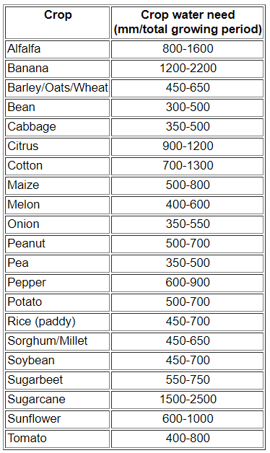
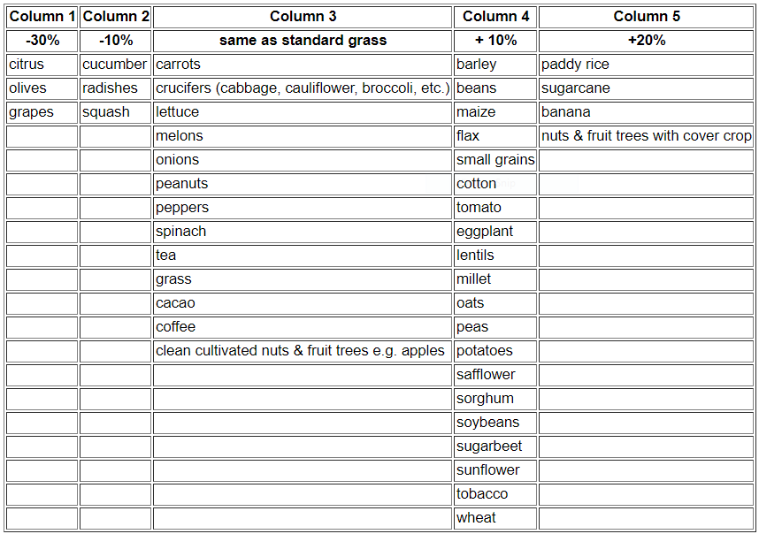
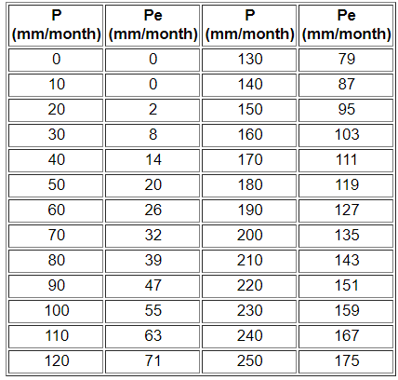
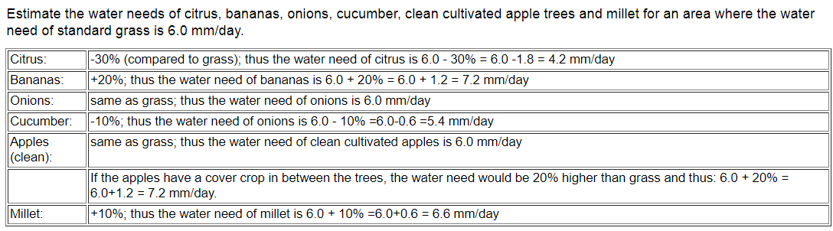
1
3
RAINFALL and EFFECTIVE RAINFALL
4
2

Slide 15
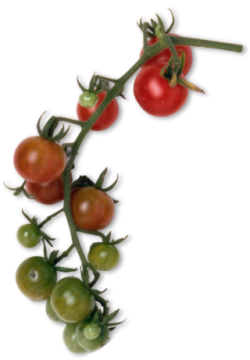
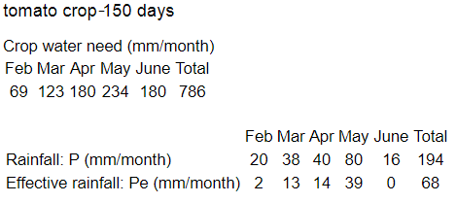
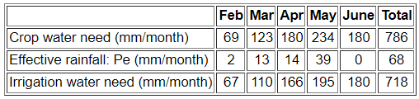


Slide 16
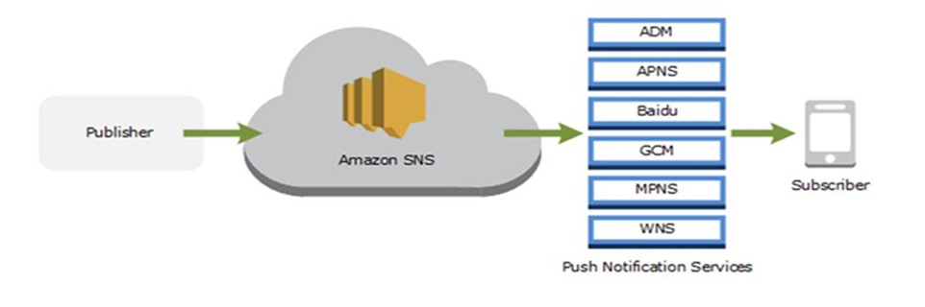
Cloud Service
Amazon Web Services (SNS Notification)
- Amazon SNS Mobile Notifications makes i t s imple and cost effective to send push notifications to i OS, Android, Fire OS, W indows based devices. to 200 +
countries. W i th SNS i t is easy to push notification to either, a subset of users, or
all of your users, using a s ingle message.

Slide 17

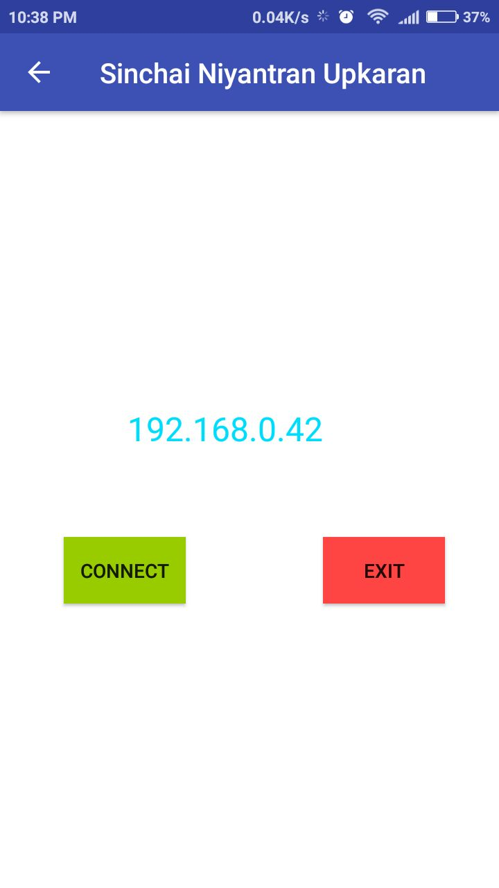
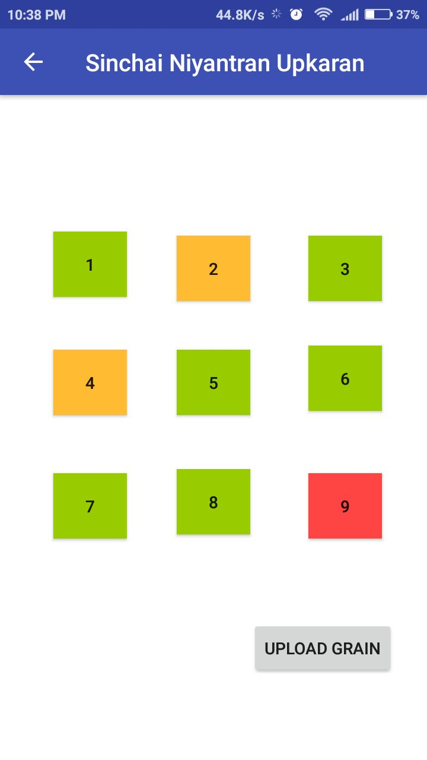

Slide 18
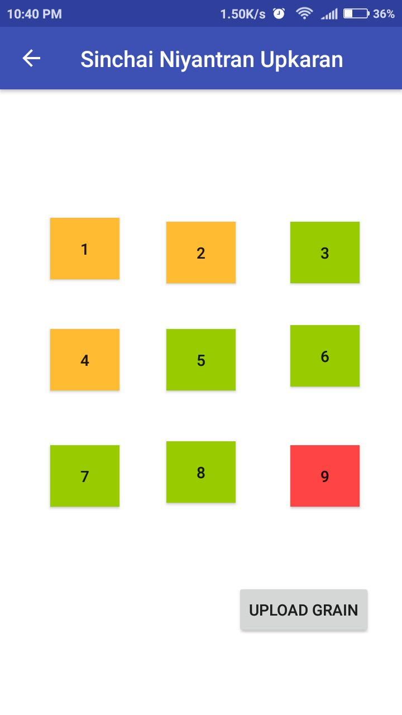
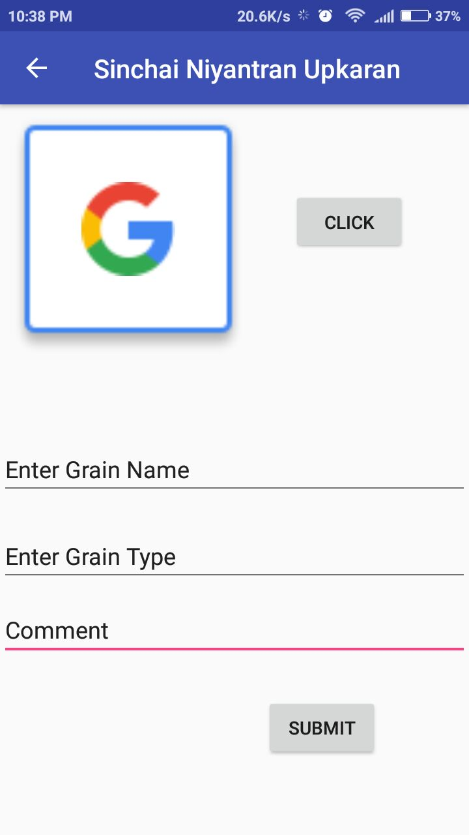
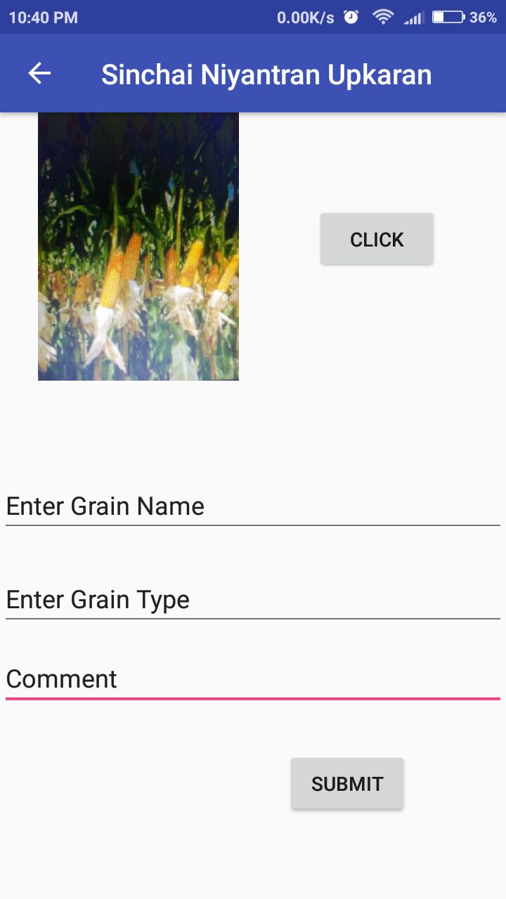

Slide 19
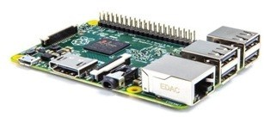
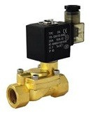
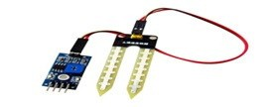

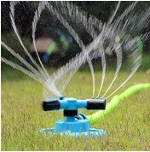
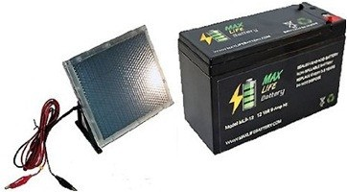
COMPONENTS USED
Raspberry Pi Board
Sn- moisture- mod
W ater Sprinkler
12 V Solenoid valve
12 V Power Supply
AW S Cloud
12 v Solar Panel
12 v Rechargeable Battery
W ater Pressure Storage Tank

Slide 20
Technical Feasibility
Device is easily operable
Data processing through AW S is Fastest.
The component are easily available
Easy app to hardware connectivity
Solar panel make system work standalone
Most of the android devices satisfies the requirement of the proj ect.
As the system is build using basic Technology,
W i reless Connectivity and Solar Energy, Proposed system is technically feasible.

Slide 21
Financial Feasibility
The product is developed using the easily component.
Product can be used by s ingle of group of
available
farmers in
case of small farm, and in case of large farm i t can also done using more than one system.
- The investment in this proj ect is comparative low, as per the product need and use.
The device can be easily extended and compact.
Hence, the Sichai Niyantran Upkaran is Financially Feasible

Slide 22
Cost Estimation
Approximate Hardware Cost:
●
Moisture sensor module
DHT sensor
Raspberry pi Zero W
12 V Solenoid valve
Adapter 12 V
W ater Sprinkler
( SN- MOI STURE- MOD)
Min. Rs 100 / - Avg. RS 210 / -
Min. Rs 1200 / -
Avg. Rs 500 / - Avg. Rs 400 / - Avg. Rs 300 / -
Avg. $ 5 . 22 Per Month=> ~ 330 I NR
Avg. Rs 2000 / - Min. Rs 4500 / - Min. Rs 1000 / -
Amazon W eb Service
12 v Solar Panel with Solar Charge Controller
12 v 1 . 3 Ah SMF/ V RLA Rechargeable Battery
Other Cost
* Minimum Cost would be: Rs. 26 , 000 approx.

Slide 23
Profitability
- The Device will ease the task of many farmers, to travel for farming.
who still have
- This will definitely save farmers t ime and energy.
Productivity will increase which help to gain
I ncrease in Crop quality
Minimum use of water
f inancial benefit
- The system is also embedded with solar panel to use of the natural resources and save energy.
make the best

Slide 24
Target Customer
The target of this proj ect is to provide a help in i r r igation system across I ndia. The targeted customer for this proj ect will be:
Local/ Rural Farmers
Urban Farmers
Commercial Farming
Sustainable Farming

Slide 25
Deployment Plan
- The proj ect will be complete toolkit made component and technology.
of different
Every device will have different id for service.
The system will be installed once and further use.
Amazon web
configured for
- Once configured, the device will report
the information
to the cloud, which will be received in Android device.

Slide 26
References
- Moisture sensor module ( SN- MOI STURE- MOD) http:// tutorial. cytron. com. my/ 2014 / 07 / 07 / mo sensor- module- sn- moisture- mod/
isture-
Arduino- based smart i rrigation using water f low sensor,
soil moisture sensor, temperature sensor and ESP 8266 W i - Fi module
Surface Soil Moisture V ariation on Small Agricultural W atersheds

Slide 27

Question ??
Do you have any
?

Slide 28

Thank-You

